Slide 1


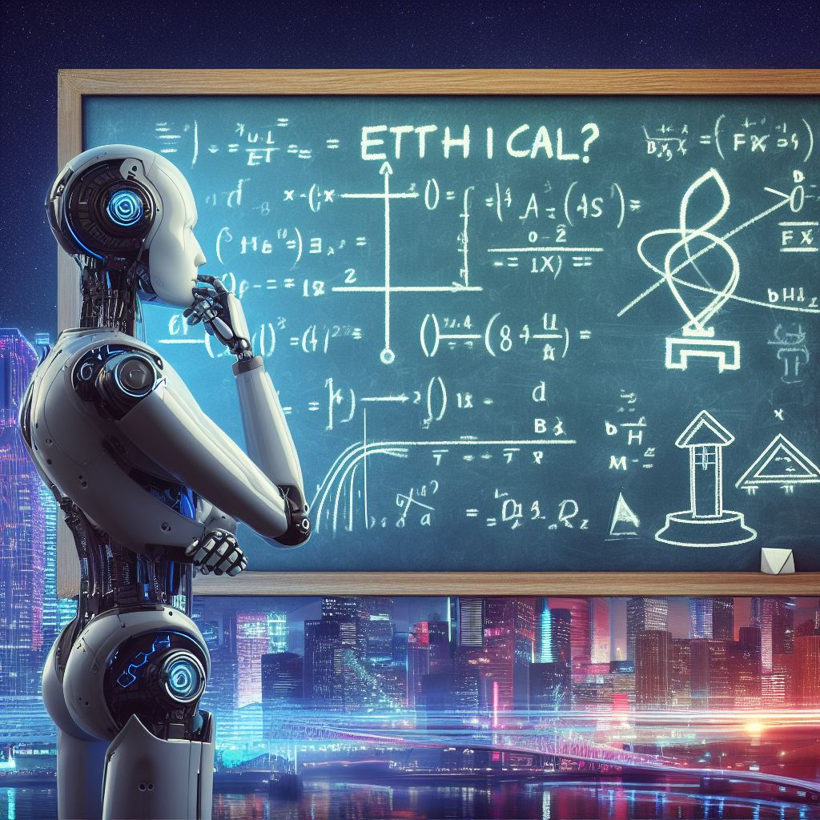



Discover the importance of Ethical AI and its applications. Explore the challenges in developing ethical AI and the role of ethics in AI decision-making.

Slide 2

Revolutionizing Industries
Unlocking the Power of Ethics
Artificial Intelligence (AI) has unleashed a wave of innovation across various industries, from healthcare to finance.
But we don't stop there! We believe in harnessing the power of AI with unwavering ethical standards.
Fostering Fairness
Embracing Transparency
Building Trust

Slide 3




Slide 4
Definition
AI refers to the development of computer systems that can perform tasks that typically require human intelligence.

Slide 5
Definition
AI refers to the development of computer systems that can perform tasks that typically require human intelligence.
Applications
Its applications range from natural language processing to autonomous vehicles.

Slide 7
Guard Against Bias
AI must be developed without bias to ensure it makes fair and unbiased decisions.

Slide 8
Guard Against Bias
Safeguard Against Discrimination
AI must be developed without bias to ensure it makes fair and unbiased decisions.
AI must be developed to avoid discrimination based on race, gender, age, or other factors.

Slide 9
Guard Against Bias
Safeguard Against Discrimination
AI must be developed without bias to ensure it makes fair and unbiased decisions.
AI must be developed to avoid discrimination based on race, gender, age, or other factors.
Prevent Harm
AI must be developed to prevent harm to humans and other living beings.

Slide 10
Guard Against Bias
Safeguard Against Discrimination
AI must be developed without bias to ensure it makes fair and unbiased decisions.
AI must be developed to avoid discrimination based on race, gender, age, or other factors.
Prevent Harm
Benefit Society
AI must be developed to prevent harm to humans and other living beings.
AI must be developed with the goal of benefiting society as a whole, not just a select few.

Slide 12
Data Privacy
Ensuring the privacy and protection of user data.

Slide 13
Data Privacy
Algorithm Transparency
Ensuring the privacy and protection of user data.
Making AI algorithms understandable and explainable.

Slide 14
Data Privacy
Algorithm Transparency
Existing Biases
Ensuring the privacy and protection of user data.
Avoiding the reinforcement of biases in AI systems.
Making AI algorithms understandable and explainable.

Slide 15

AI systems make decisions that impact individuals and communities. Incorporating ethical considerations into AI decision-making processes ensures:

Slide 16
AI systems make decisions that impact individuals and communities. Incorporating ethical considerations into AI decision-making processes ensures:
Fairness
Ensure that AI decisions are unbiased and treat all individuals fairly.

Slide 17
AI systems make decisions that impact individuals and communities. Incorporating ethical considerations into AI decision-making processes ensures:
Fairness
Accountability
Ensure that AI decisions are unbiased and treat all individuals fairly.
Hold AI systems accountable for their decisions and actions.

Slide 18
AI systems make decisions that impact individuals and communities. Incorporating ethical considerations into AI decision-making processes ensures:
Fairness
Accountability
Human Values
Ensure that AI decisions are unbiased and treat all individuals fairly.
Hold AI systems accountable for their decisions and actions.
Respect and uphold human values when making AI decisions.

Slide 19
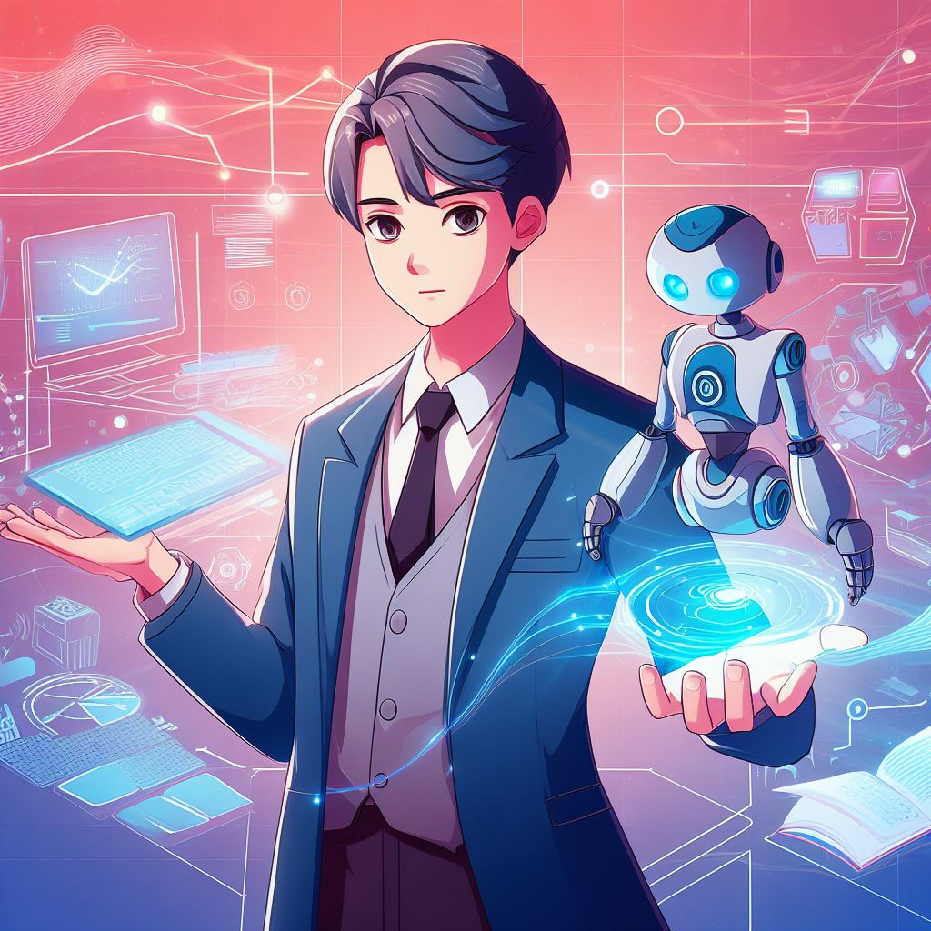


Slide 20
1
Principles-Based Frameworks
These frameworks provide high-level ethical principles to guide AI development and deployment, such as fairness, transparency, and accountability.

Slide 21
1
Principles-Based Frameworks
These frameworks provide high-level ethical principles to guide AI development and deployment, such as fairness, transparency, and accountability.
2
Process-Oriented Frameworks
Process-oriented frameworks focus on the development lifecycle, emphasizing responsibility throughout design, development, and testing phases.

Slide 22
1
Principles-Based Frameworks
These frameworks provide high-level ethical principles to guide AI development and deployment, such as fairness, transparency, and accountability.
2
Process-Oriented Frameworks
Process-oriented frameworks focus on the development lifecycle, emphasizing responsibility throughout design, development, and testing phases.
3
Impact-Driven Frameworks
These frameworks assess the potential social, economic,
and environmental impacts of AI solutions. The goal is to optimize benefits and minimize harm.

Slide 23



Slide 24
Regulations
Regulations are essential to ensure the responsible use of AI.

Slide 25
Regulations
Regulations are essential to ensure the responsible use of AI.
Governance
Governments, organizations, and industry collaborations play a key role in developing policies and standards.

Slide 27
Continuous adaptation
The future of AI relies on continuous adaptation of ethical guidelines.

Slide 28
Continuous adaptation
Ongoing research
The future of AI relies on continuous adaptation of ethical guidelines.
Research is necessary to help shape the future of AI that aligns with societal values.

Slide 29
Continuous adaptation
Ongoing research
The future of AI relies on continuous adaptation of ethical guidelines.
Research is necessary to help shape the future of AI that aligns with societal values.
Collaboration
Collaboration is essential for developing ethical guidelines for AI.

Slide 30
Continuous adaptation
Ongoing research
The future of AI relies on continuous adaptation of ethical guidelines.
Research is necessary to help shape the future of AI that aligns with societal values.
Collaboration
Public engagement
Collaboration is essential for developing ethical guidelines for AI.
Public engagement is necessary to ensure that AI is developed in line with societal values.

Slide 31



Slide 32
Striking a balance between AI innovation and ethics is crucial for harnessing its full potential while safeguarding against unintended consequences.

Slide 33
Striking a balance between AI innovation and ethics is crucial for harnessing its full potential while safeguarding against unintended consequences.
Ethical AI can reshape industries for the better.

Slide 34





@prasanth__p_

